Slide 1
Veterans Independence Program Presentation to the Care and Support Advisory Group July 26, 2017

Slide 2
Objective
To provide the Care and Support Advisory Group with :
background on the development of the Grant Determination Tool (GDT) and its link with the Veterans Independence Program
an overview of the GDT
what has changed as a result of the introduction of the GDT

Slide 3
Background
Blue Ribbon Panel on Grants and Contributions and government emphasis on streamlining program delivery identified benefits of VIP grants
Grants reduce red tape and recipients avoid being out-of- pocket for housekeeping and grounds maintenance benefits
A tool was needed to determine grant amounts
The tool had to respect the VIP Maximum rates payable, as outlined in the Veterans Health Care Regulations
The GDT was developed to fulfill this need

Slide 4
Development of GDT
The principles used to guide the development of the GDT were:
Cost-neutral
Needs-based
Efficient
Consistent
Defensible

Slide 5
Overview - What is the GDT?
The GDT:
is a worksheet that standardizes the way Housekeeping and Grounds Maintenance amounts are calculated
ensures fairness in calculating amounts by removing discretion
calculates “Level of Need score” based on a standard series of weighted questions and assigns one of six “Level of Need categories” ranging from “minimal” to “maximum”
these “Level of Need categories” are then directly linked to the level of assistance provided – e.g. minimal = 1 hour per week; maximum = 2 hours per day

Slide 6
Overview - How Rates Determined
Maximums established based on:
Review of prevailing rates for similar services across the country
Surveys of rates from independent service providers
Review of the VAC payment history for these services
Rate information compared to the median Labor Market Index rates published by ESDC and maximum rates adjusted annually based on changes to these rates
Maximum rates for 76 economic regions
GDT calculation based on the assessed level of need and the maximum rates in client’s economic region

Slide 7
.
Overview – Housekeeping
Treasury Board requirement
Responses are assigned a “Level of Need” score
Level of Need score converted into “hours of service”
Hours of services are multiplied by the rate in rate table

Slide 8
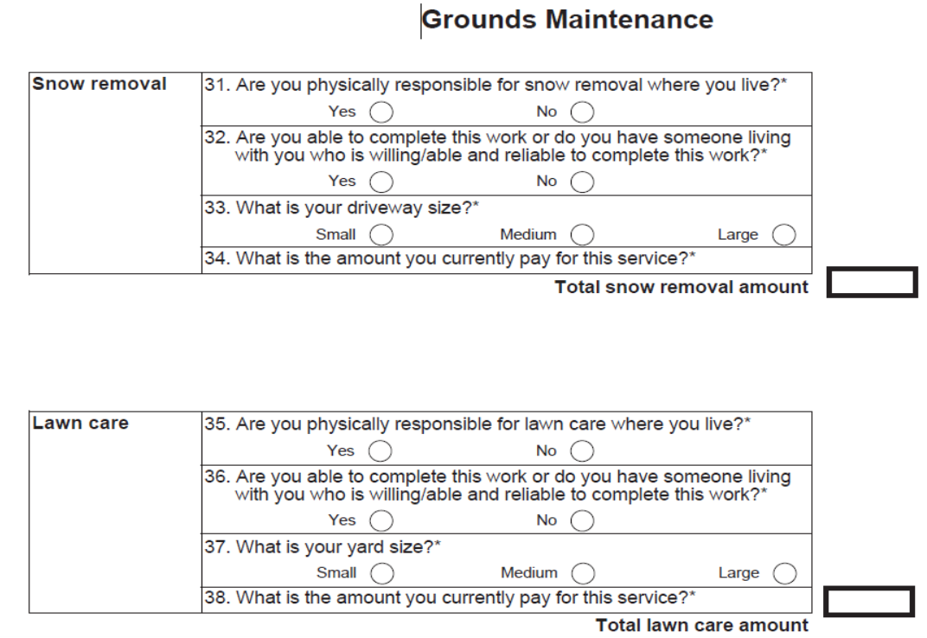
.
Overview – Grounds Maintenance
Responses to Questions 33 and 37 are matched to the corresponding rate in the Rate Table
Rates are based on the client’s location

Slide 9
What has Changed?
No longer registered service providers – recipients must pay housekeeping and grounds maintenance providers
No need to collect and submit receipts
Funding for window washing now included in housekeeping
Benefit Arrangements are less, however expenditures remain consistent
Both VAC staff and MBC contractors are able to calculate benefits using the GDT.

Slide 10
Discussion

