Slide 1
STRATEGY FOR FAMILIES
Communications Strategy for Families
April 2019

Slide 2


A NEED FOR CHANGE
Veterans and their families have given us clear feedback.
Our information is too complex.
Veterans and their families don’t understand our programs and benefits.
We’re not communicating in a consistent way.

Slide 3
HOW WE ARE CHANGING
We are adjusting to better meet their needs.
CLEAR LANGUAGE
TRANSPARENT MESSAGING
USER TESTING
More consistent
More concise
More responsive
More adaptable
WEB USABILITY
SOCIAL MEDIA STRATEGY
VISUAL IDENTITY

Slide 4
OUR VISION GOING FORWARD
Focus on the outcomes of our benefits and services
We launched new programs in April 2018, and Pension for Life took effect on 1 April 2019. We have been communicating with Veterans and their families about these programs regularly over the last year. We must continue to offer you clear, helpful information.
Reinforce the importance of well-being
Well-being – for Veterans and their families – is the core of all our program, delivery and communication efforts. Family members should easily see a direct connection between programs and services and well-being.
Be extremely responsive, adaptable and consistent
We are using tools like social media and face-to-face outreach to identify and adapt to the questions, concerns or gaps in information you may have. Real time responses, two-way dialogue and consistency of the message are essential.
Learn and adapt as we go
We are monitoring feedback, analytics and other data to make sure our information reflects the needs of families. We are constantly looking for ways to improve, based on evidence like your feedback.
Sustain and build on PFL implementation
We are now one month into PFL implementation. We must continue to provide information about services and benefits and how you can access them.

Slide 5
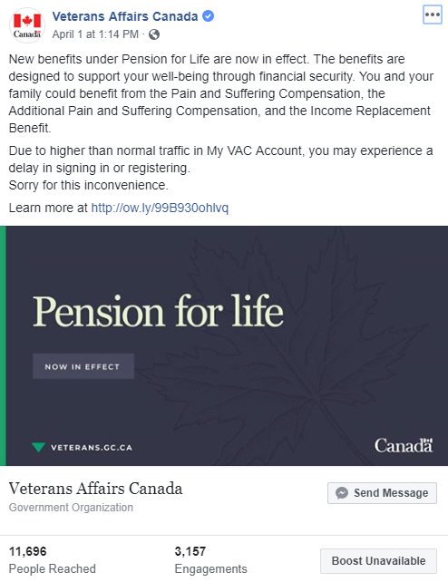
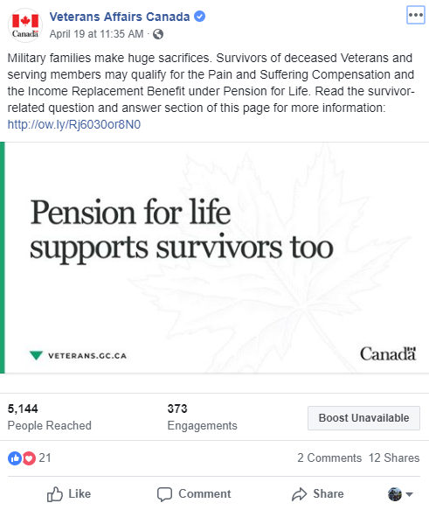
RESULTS
Family-related web traffic on veterans.gc.ca grew 222% between March 2018 and March 2019.
Notes:
Note: The increase from March 2018 to March 2019 is largely in response to the web renewal – it measures the pre-renewal traffic to post renewal. We were able to bring quality content, in demand, to the front/make accessible.
March 2018: 3,313 page views
March 2019: 10,677 page views
The “family pages” includes:
Full section of “Families and caregivers” of the website (https://www.veterans.gc.ca/eng/family-caregiver)
Covers all the programming that has a family element (examples: Caregiver Recognition Benefit, Caregiver Zone, OSISS, survivor’s pension, IRB, etc.)
RCMP sub-section “You and your family” (https://www.veterans.gc.ca/eng/rcmp/you-and-your-family)
Transition interview
Case management

Slide 6
DEVELOPING THE STRATEGY
How can we help?
Who are the families we need to reach most?
How can we best reach them?
What information gaps exist?
What do we need to know in planning our communications that we might not have considered?
What opportunities should we explore?

