Slide 1

VETERANS WELL-BEING
FRAMEWORK
Policy Advisory Group
May 2019

Slide 2
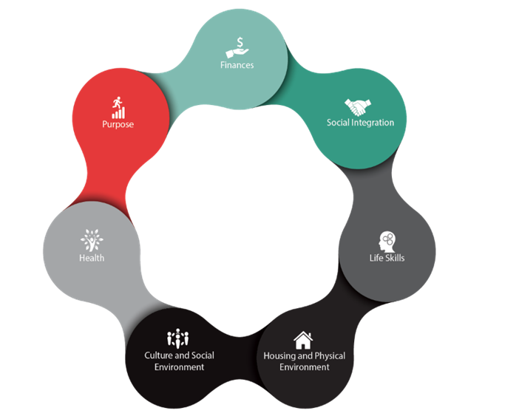
Well-being
Well-being has long been the desired outcome for Veterans.
There was no standard definition for “well-being”.
A conceptual framework has been developed which indicates that enabling the well-being of Veteran’s involves examining and taking action in seven domains
Domains of
Well-being
Notes:
Definition of well-being
While most agreed well-being was about living well, there was no standard definition for “well-being”. This was challenging from a policy perspective, as it is hard to chart a course toward an undefined destination (outcome).
Conceptual Framework
To support the Department, the Research Directorate led the development of a conceptual framework of Veteran well-being, in collaboration with the Strategic Policy team.
The framework emerged at VAC over the past decade in a consensus-seeking, multidisciplinary process informed by reviews of international professional literature, consultations with experts in other nations and evidence from the Life After Service Studies.
Seven Domains
The conceptual framework indicates that enabling the well-being of Veteran’s involves examining and taking action in seven domains. Well-being considers how an individual or population is doing across all these domains.
The domains are key areas of life important to successful transition to post-military life and living well throughout the remainder of Veterans’ lives.

Slide 3
Domains of Well-Being
Domain | Description | Outcome
Purpose | Purpose is the sense of meaning attained by participation in fulfilling activities, such as employment. | Veterans are engaged in activities that are beneficial and meaningful to them.
Finances | Finances includes household income and financial security. | Veterans are financially secure
Health | Heath is a state of physical, mental, social and spiritual functioning, broader than the presence or absence of disease. | Veterans are functioning well physically, mentally, socially and spiritually.
Social Integration | Social integration is engagement in mutually supportive relationships (friends, family, community). | Veterans are in mutually supportive relationships and are engaged in their community
Life Skills | Life skills enable the management of life and contribute to resilience; they include personal health practices, coping skills and education. | Veterans are able to adapt, manage, and cope.
Housing and Physical Environment | Housing and physical environment includes the built environment (e.g., housing) as well as the natural environment (e.g., water and air quality). | Veterans are living in safe, adequate and affordable housing.
Culture and Social Environment | Culture and Social Environment is the impact of the dominant values, beliefs and attitudes of society on the well-being of a population. | Veterans are supported by the culture and social environment (understood and valued by Canadians.).
Notes:
The domains are interconnected and interdependent. Each domain influences every other domain. Each Veteran will experience the domains in different and deeply personal ways over his/her life-course, influenced by many factors in all the well-being domains.
The column on the right are the defined desired outcomes. These outcome statements are intended to capture the stable and enduring "desired states" or “ideal” that we are working towards. They represent an end-state or goal, to which we are constantly contributing through our programs, strategies and alliances. They are enduring and are not temporal/ time-based; they express "ends" as opposed to "means“. These outcomes are different from objectives which are time-based (short-, medium- and long-term).
To support the well-being of veterans and their families, strategies are required across all the domains and involve multiple players who all have roles to play: the Veteran and their family on the one hand, and communities, and public/private sectors on the other.

Slide 4
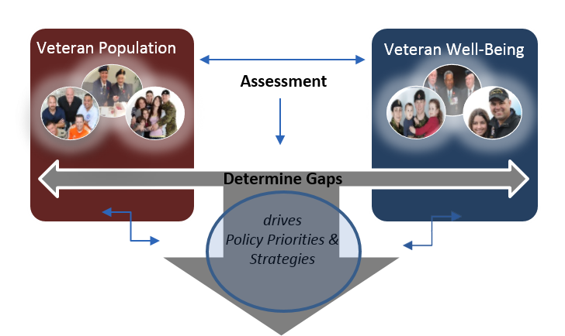
Well-being Informing VAC Programs /
Strategic Policy Agenda
Notes:
VAC has clearly defined outcomes for the well-being of Veterans. This is the square on the right (the “ideal”).
The square on the left is the Veteran population. In order to be able to measure how the Veteran population is doing as compared to the desired outcomes, VAC developed a comprehensive Well-being Surveillance Framework. The Strategic Policy Unit worked in collaboration with VAC’s Epidemiologist and Health Economist (Research Division) to build an accepted set of high level indicators to monitor Veteran well-being in each domain. The first Veterans Well-being Surveillance report is in progress and will be released in the coming months. One of the main data sources is the Life After Service Survey (LASS). The indicators in this framework are closely linked and aligned with the Departmental Results Framework.
Issues are identified by describing the Veteran population to comprehensively understand their challenges, and by assessing the gaps in their well-being (left of image) when weighed against the desired well-being outcomes (right of image).
Measuring the well-being of the population and analyzing the gaps (centre of image) will help VAC to develop strategies and direct resources at the areas of need (drive research and policy agendas – bottom of image). Strategic policy development and action (e.g. champion & advocate, navigate & coordinate, strategies, programs & benefits) occur based on identified areas of need/gaps.
Action taken is evaluated against the desired well-being outcomes.
The cycle begins again.

